Slide 1
Event Sourcing

Slide 2
Agenda
Core Components of Event Sourcing
Short Intro to event sourcing High-Level Workflow
Credit UseCase Event
Event Sourcing Model
Event Sourcing Database
Events Abstract
Demo

Slide 3
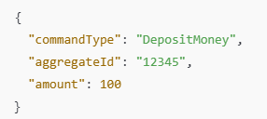
Core Components of Event Sourcing
Event Store
A specialized database or storage system where all events are stored chronologically and immutably.
Serves as the source of truth.
Example events for a banking system: AccountCreated, MoneyDeposited, MoneyWithdrawn
Domain Events
Represent facts about something that has happened in the domain.
Immutable and time-stamped.
Aggregates
Aggregates are domain objects that encapsulate business logic and ensure consistency within a bounded context.
Handle commands and produce events.
Example: A BankAccount aggregate could process the DepositMoney command and emit the MoneyDeposited event.
Commands
Represent intentions to perform an action in the system (e.g., "Deposit $100").

Slide 4
Core Components of Event Sourcing
5. Command Handlers
Receive commands, validate them, and delegate the processing to the appropriate aggregate.
Example workflow:
Input: DepositMoney command.
Validate: Ensure the account exists and the amount is positive.
Output: Emit MoneyDeposited event.
6. Event Handlers
React to events and execute side effects.
Example: An AccountSummaryProjection might update the current balance whenever a MoneyDeposited or MoneyWithdrawn event is emitted.
7. Projections (Read Models)
Derived data structures optimized for queries, updated by processing the event stream.
Examples:
An AccountBalance projection for quick balance checks.
A TransactionHistory projection for user reports.

Slide 5
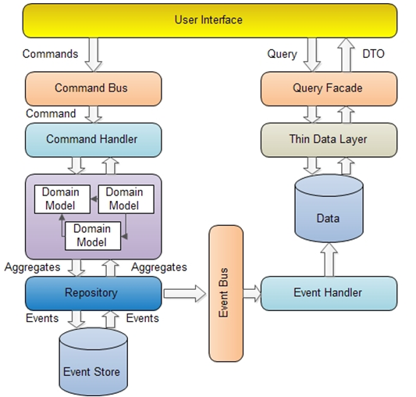
High-Level Workflow

Slide 6
High-Level Workflow
1 - Receive a Command:
A Represent intentions to perform an action in the system (e.g., DepositMoney („ Geld einzahlen“)) is sent to the system.
2 - Validate the Command:
The command handler ensures that the command satisfies business rules.
3 - Process the Command via Aggregate:
The aggregate applies domain logic and emits one or more events if valid.
4 - Store Events in the Event Store:
The generated events are appended to the event store in chronological order.
5 - Update Projections:
Projections subscribe to the event store and update their derived data structures in response to new events.
6 - Query Projections for Read Operations:
Queries retrieve data from projections instead of replaying all events.
Generate optimized views or summaries of events, making querying and reporting efficient.

Slide 7
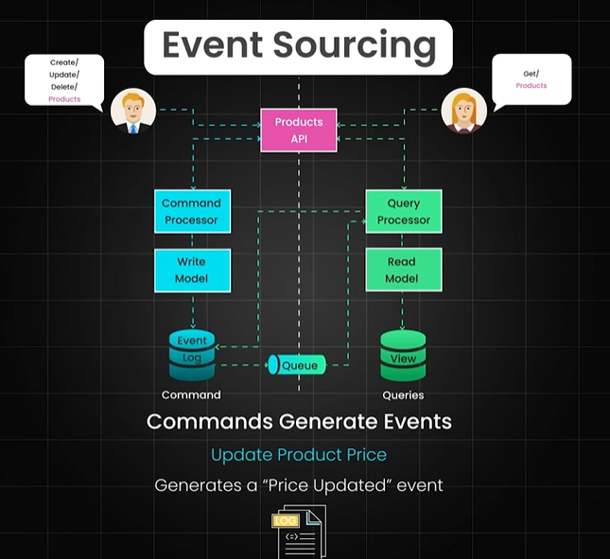
High-Level Workflow

Slide 8
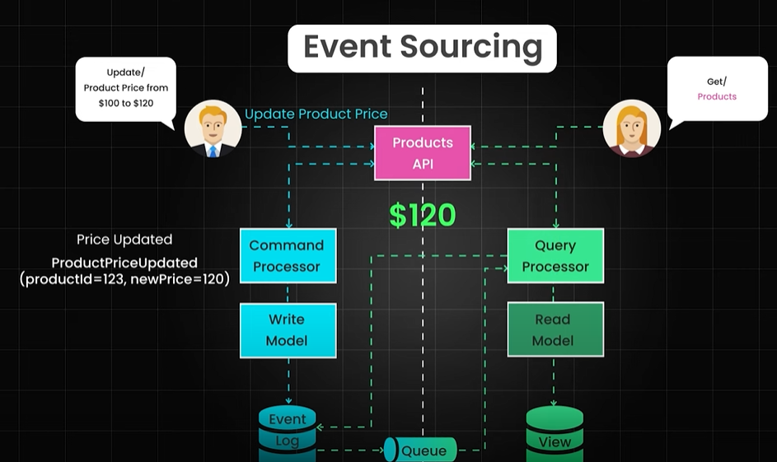
example

Slide 9
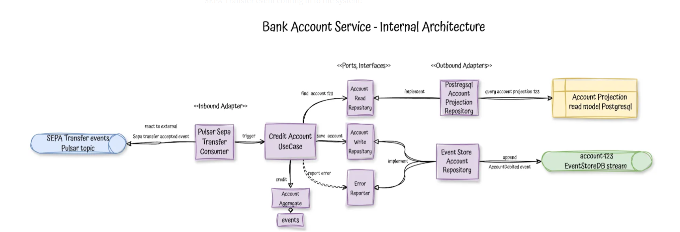
Credit UseCase Event

Slide 10
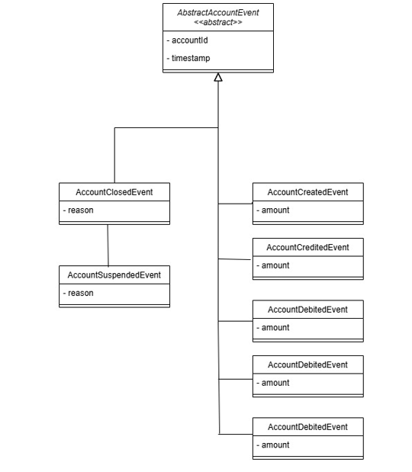
Event Model Class Diagram

Slide 11
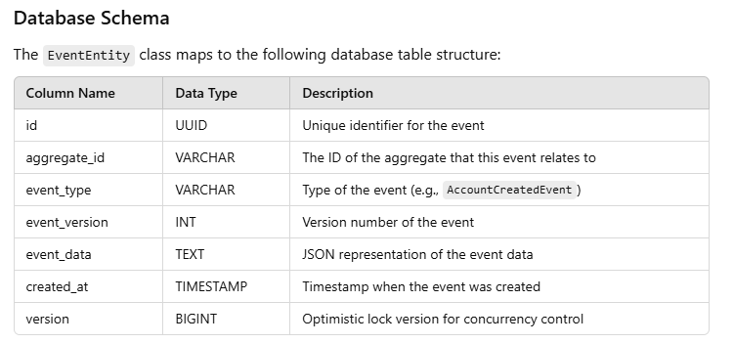
Database Schema

Slide 12
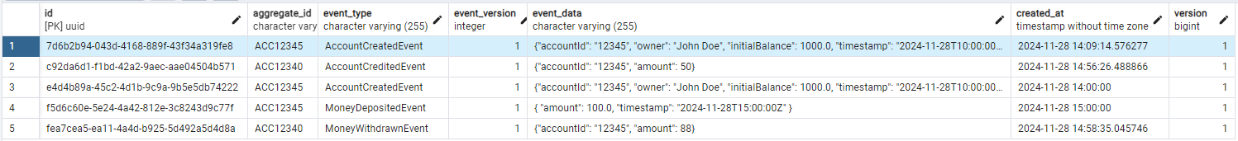
Event Table
CREATE TABLE EventEntity (
id UUID PRIMARY KEY,
aggregate_id VARCHAR(255),
event_type VARCHAR(255),
event_version INT,
event_data TEXT,
created_at TIMESTAMP,
version BIGINT
);

Slide 13
Example
Command: DepositMoney
Command Type: "DepositMoney„
Aggregate ID: "12345"
Amount: 100
2. Aggregate (BankAccount)
Applies logic: Ensure amount > 0
Emits Event: MoneyDepositedEvent
3. Event Store
Append Event:
{
"eventType": "MoneyDepositedEvent",
"aggregateId": "12345",
"amount": 100,
"timestamp": "2024-11-29T10:00:00Z"
}
4. Projection: AccountBalance
Reacts to "MoneyDeposited" event.
Updates Balance: Balance += 100
5. Query
Reads balance from `AccountBalance` projection.

Slide 14
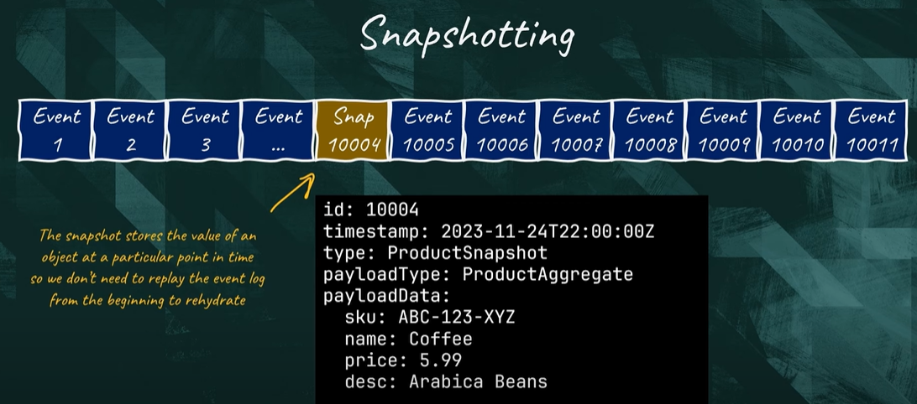
Snapshotting

Slide 15
Demo

